Slide 1
Data Science for the Public Good – Overview of Summer Projects
May 24, 2016

Slide 2
Reviewing Arlington County’s Open Data Portal (group project)
Sponsor: Arlington County Deputy Chief Information Officer Kristanne Littlefield
Review available guidelines on open data portals
Review cities open data portal – a mix of large (e.g. Chicago, Boston, San Francisco, DC) and small cities (e.g. Portland, OR or ME, Charleston, SC, Richmond)
Using guidelines and review of other portals, develop criteria for evaluating Arlington County’s Open Data Portal. - http://topics.arlingtonva.us/open-government-resources/
Evaluate Arlington County’s Open Data Portal and prepare report* (see notes)
Notes:
Some examples of Criteria for Open Data Portals:
http://labs.centerforgov.org/open-data-portal-requirements/
http://sunlightfoundation.com/opendataguidelines/
http://www.nlc.org/Documents/Find%20City%20Solutions/City-Solutions-and-Applied-Research/CSAR%20Open%20Data%20Report%20FINAL.pdf
One suggestion – each student evaluate 1 to 2 AC pages.
Report format can be a written report, PowerPoint, wiki or other format that best presents the findings.

Slide 3
Reviewing Arlington County’s Open Data Portal (group project)
Review other
Enigma open data portal (Emily Molfino) - https://app.enigma.io/search
NORC GSS Survey data portal (Sam)
Immigration data (Jess)

Slide 4
Reviewing Arlington County’s Open Data Portal (group project)

Slide 5
Measuring Social Cohesion – Prepare Literature Review (group project)
Defining Social Cohesion - the quality and quantity of relationships within a community with an emphasis on connectivity and trust (one definition)
Conduct literature review – Katie will introduce method
Create outline/timeline - each student select topic/topics
Prepare draft paper (by July 22) and poster (July 28)
Review earlier draft as a starting point - see Social Cohesion folder on Google drive
Notes:
We are interested in understanding communities. Social cohesion is an important facet of community character. We can think of communities by area, e.g. Arlington County, or smaller geographic areas, such as neighborhoods in Arlington.
Social cohesion is an important part of communities and is relevant to its long-term stability, health, and prosperity; socially cohesive communities are likely to be more resilient in disasters and other shocks, and may be healthier and better at advocating for their needs. Social cohesion might be thought of as a combination of the quality and quantity of relationships within a community, for example, densely connected social networks combined with norms of trust within those networks is on.
Social cohesion is difficult to measure directly, so surveys and studies, whose primary goal is to ascertain aspects of social capital, generally use a battery of questions that attempt to touch upon different aspects thought to be indicative of cohesive communities. The diversity of questions asked in such surveys reflects both a degree of academic uncertainty about what constitutes social cohesion and to some degree it reflects an understanding that social cohesion may manifest itself differently in different kinds of communities.

Slide 6
1. Counting Employment in Arlington County Using Multiple Methods and Data
Sponsor: Arlington County (Andrew J. D'huyvetter and Elizabeth Hardy, Urban Planners/Demographers, Department of Community Planning, Housing & Development
Project: Estimate Arlington County’s employment using top-down and bottom-up methods
Use BLS QCEW (quarterly census of employment and wages) – top down
Use per square feet of leased office space less vacancies, water usage, and commercial building information – bottom-up
Steps – literature review, exploratory data analysis, statistical analysis
Meeting with Northern Virginia demographers on May 24, 2 to 3:30
Notes:
Counting Employment in Arlington County and Northern Virginia Using Multiple Methods and Data;
The Metropolitan Washington Council of Government (MWCOG) distributes federal funds (primarily for transportation) to localities based on population and employment. The MWCOG requests that each county/city compute employment following a standardized approach. AC believes the MWCOG method, which relies on Bureau of Labor Statistics (BLS) QCEW (quarterly census of employment and wages) underestimates Arlington County (AC) computes their employment forecasts using a bottom up method, block by block. For employment, they calculate employment based on per square feet of leased office space less vacancies, water usage, and commercial building information (COSTAR data). We will invite the BLS economists who oversee the QCEW to do a brownbag lunch.

Slide 7
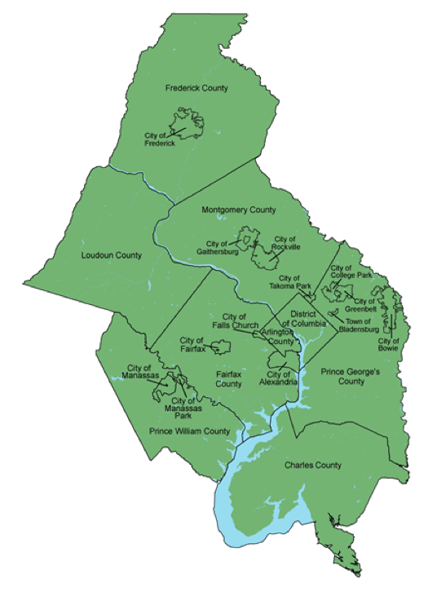
1. Counting Employment in Arlington County Using Multiple Methods and Data
Metropolitan Council of
Governments: is an independent, nonprofit association that brings area leaders together to address major regional issues in the District of Columbia, suburban Maryland and Northern Virginia.
Notes:
Counting Employment in Arlington County and Northern Virginia Using Multiple Methods and Data;
The Metropolitan Washington Council of Government (MWCOG) distributes federal funds (primarily for transportation) to localities based on population and employment. The MWCOG requests that each county/city compute employment following a standardized approach. AC believes the MWCOG method, which relies on Bureau of Labor Statistics (BLS) QCEW (quarterly census of employment and wages) underestimates Arlington County (AC) computes their employment forecasts using a bottom up method, block by block. For employment, they calculate employment based on per square feet of leased office space less vacancies, water usage, and commercial building information (COSTAR data). We will invite the BLS economists who oversee the QCEW to do a brownbag lunch.

Slide 8
2. Arlington County 911 data
Sponsor: AC
Contacts: Captain Bruce Benson (Police) Battalion Chief Mike Gowen (Fire/EMS)
Description: We will repurpose the 911 data, identify interesting research questions (raised by AC fire and police departments, and found from literature reviews), and conduct exploratory data analysis and develop models to address those questionshttps://collaboration.vbi.vt.edu/display/FPSDSP/Our+Work+with+Arlington+County
Methods: Data exploration, statistical analysis, visualization
First project: Analyze fire alarm data after quick literature review.

Slide 9


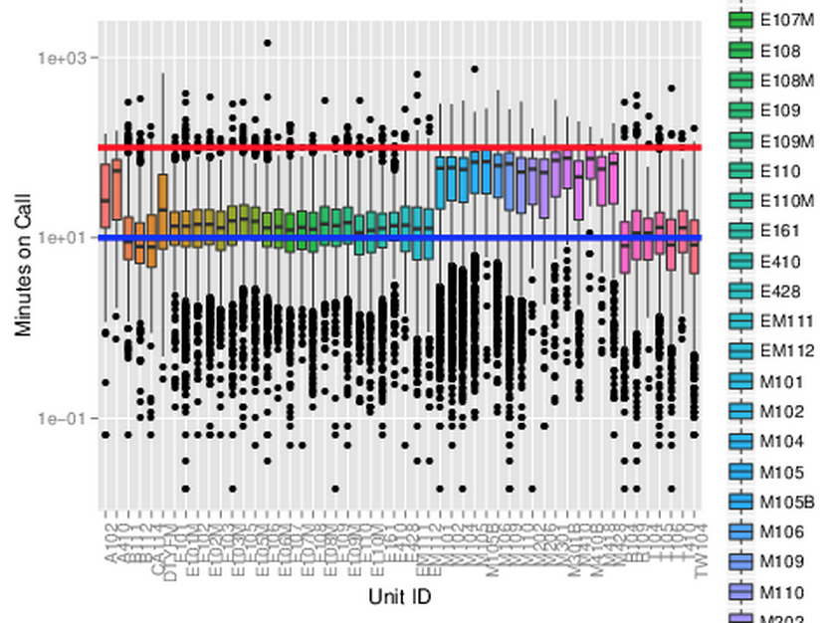
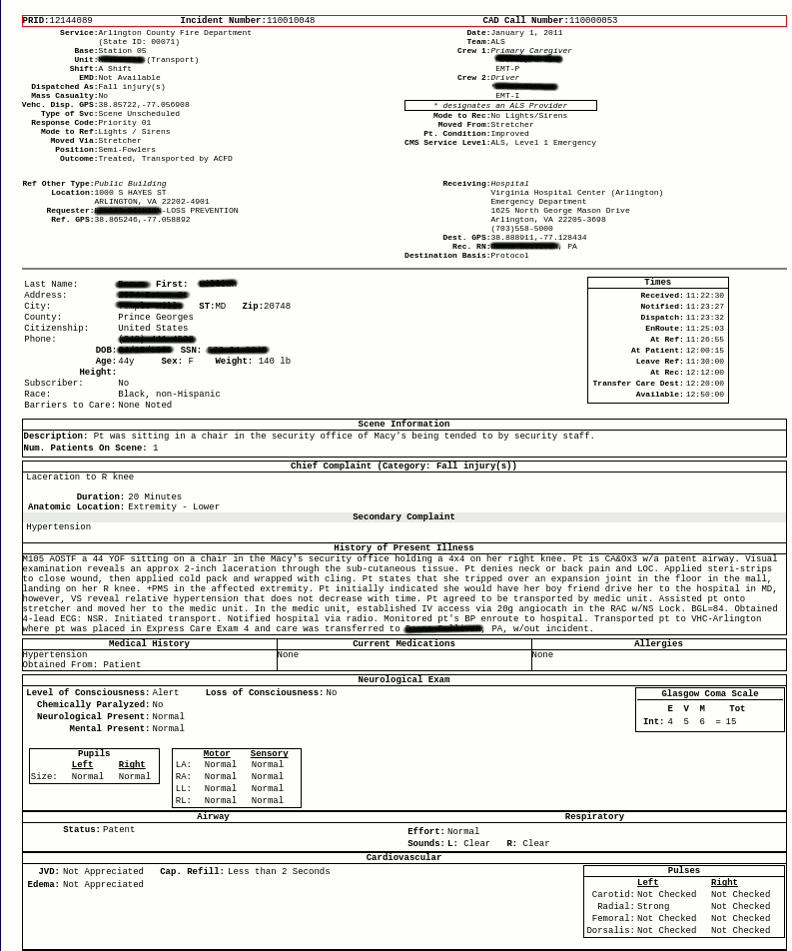

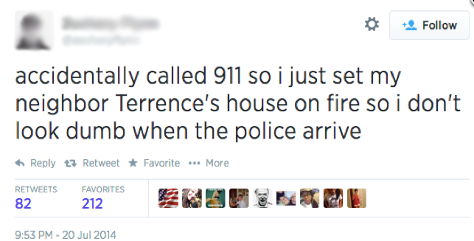
Notes:
Battalion Chief Mike Gowen was terrific in taking us on tours of the CAD center and FD and helped us understand how the data were born. This is an example of the digital traces that Sallie talked about.
The call comes into the CAD center, the same resources are deployed, no matter the urgency of the event, after action reports are prepared for each fire and medic unit sent out. But none of these data are integrated to look at incidents end to end.
We were able to connect the data requiring much wrangling and reverse engineering of the data.

Slide 10

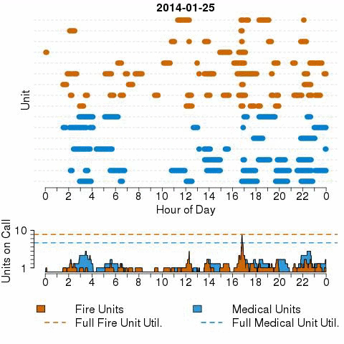
Unit Utilization
Linking Time Across Incidents
Minutes on Call
Notes:
Mike – we worry about running out of medic units

Slide 11
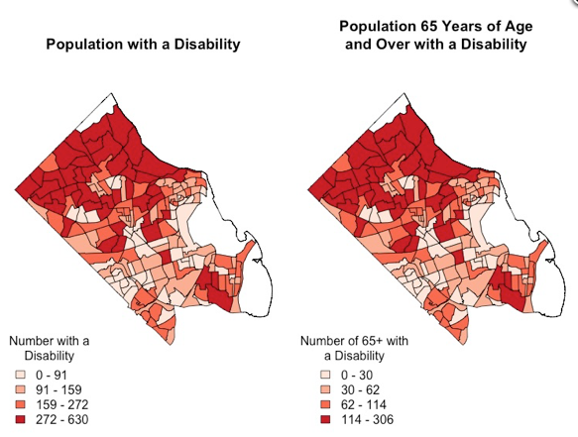
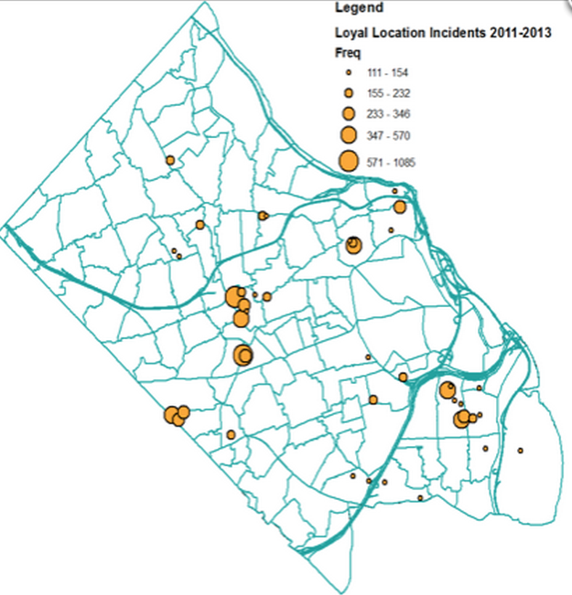
Do we have loyal customers or loyal locations?
Link up data with geography
Identifies hotspots
Deeper look into data and find these align with populations at risk in community
Notes:
Our hot spots don’t rely on tracking people, but allow you to identify the hot spots through the rhythm.
Tie back to federal data – identifying vulnerable populations. With one single data flow, we found where to look for them,

Slide 12
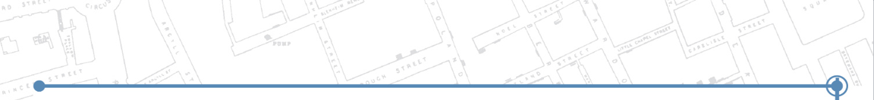
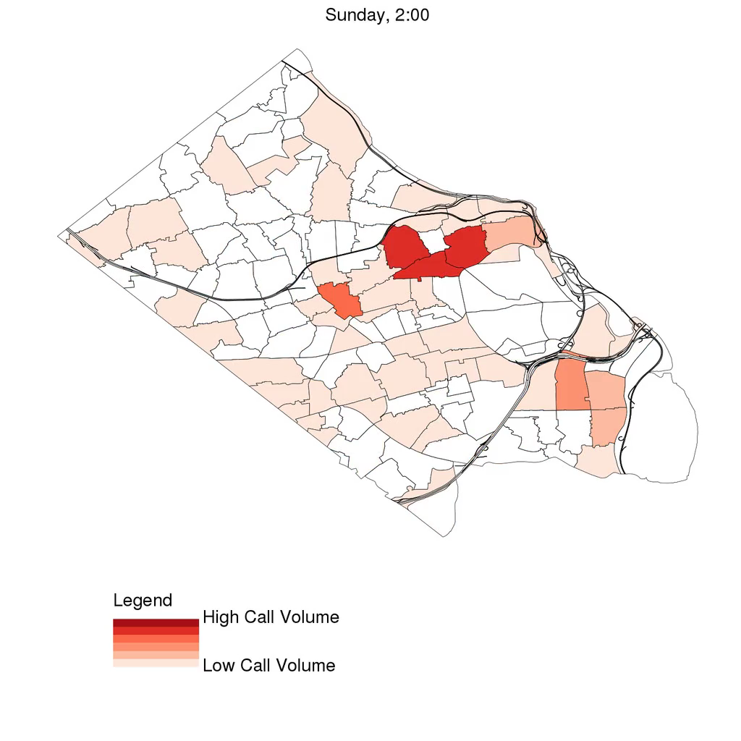
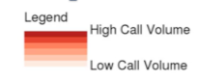
Through this single source we have identified a rhythm of the city
What do you think the data are telling us?

Slide 13
3. Arlington County Emergency Alerts
Emergency Alerts: emails, texts, phone calls alerting people of weather, road closures, crimes, and other emergencies.
Data
Lats and longs of 20,000 users
Research Questions
How to reach more people with alerts?
Where’s the best place to target marketing?
Where do the people currently getting alerts live?

Slide 14
4. Arlington County Data Discovery Workshop
May 5, 2016. Included 90 senior leaders across 19 Arlington government Departments.
First Data Discovery Workshop was with the Arlington government’s executive management team.
Team members broke into small groups to brainstorm about the issues and problems facing their community. To obtain a more complete assessment of the issues, each group included team members from across the various Arlington departments and agencies.
SDAL has since met with the Arlington steering committee selected at the Data Discovery Workshop to discuss and select issues
Our objective is for local government leaders to become self-sufficient in using their administrative data flows, linked with other data sources, to address social policy issues using data as evidence.
Notes:
In the first meeting we were encouraged by the steering committees’ acknowledgement that the first step is to take an inventory of the data sources across departments and agencies along with the analytic competencies of the employees. In subsequent meetings SDAL will help the steering committee frame one or two of the issues from the Data Discovery Workshop in a format that lends itself to intervention and evaluation using the linked data sources.

Slide 15
4. Arlington County Data Discovery Workshop
“Who is using Arlington resources and who is being left out? Why? How can Arlington’s data be linked, analyzed, and used to identify and reach those left out?”
“How do you consolidate information across departments and agencies to identify and help vulnerable populations?”
“How do you reach underserved populations? Who is not being reached?”
“What kind of facilities do we need, e.g. libraries, pools, fire stations, places for adult education, and English as a second language, and where should they be located to have the maximum impact?”
“Who are we getting feedback from, are thy the majority or minority? Does this bias how we govern? How can we engage all Arlington citizens?”
Notes:
Our first Data Discovery Workshop was with the Arlington government’s executive management team. The team was introduced to our concept of Community Learning. After the presentation, team members broke into small groups to brainstorm about the issues and problems facing their community. To obtain a more complete assessment of the issues, each group included team members from across the various Arlington departments and agencies. Recurrent themes that ran through the brainstorming session were:
“Who is using Arlington resources and who is being left out? Why? How can Arlington’s data be linked, analyzed, and used to identify and reach those left out?”
“How do you consolidate information across departments and agencies to identify and help vulnerable populations?”
“How do you reach underserved populations? Who is not being reached?”
“What kind of facilities do we need, e.g. libraries, pools, fire stations, places for adult education, and English as a second language, and where should they be located to have the maximum impact?”
“Who are we getting feedback from, are they the majority or minority? Does this bias how we govern? How can we engage all Arlington citizens?”
SDAL has since met with the Arlington steering committee selected at the Data Discovery Workshop to discuss and select the issues to move forward with. In the first meeting we were encouraged by the steering committees’ acknowledgement that the first step is to take an inventory of the data sources across departments and agencies along with the analytic competencies of the employees. In subsequent meetings SDAL will help the steering committee frame one or two of the issues from the Data Discovery Workshop in a format that lends itself to intervention and evaluation using the linked data sources. Our objective is for local government leaders to become self-sufficient in using their administrative data flows, linked with other data sources, to address social policy issues using data as evidence.
Held May 5, 2016. Included 90 senior leaders across 19 Arlington government Departments.

Slide 16
5. SLDS K-12 to Higher Education Transitions
Have K-12, higher education, and workforce longitudinal data from Kentucky
Develop research questions through literature search
Determine which variables to use within the Kentucky SLDS data
Profile, clean, and analyze data and write up findings into a research paper.

Slide 17
6. HUD Exploring Disclosure Avoidance in Federal Surveys by Using Local Data
Exploring disclosure avoidance in the American Housing Survey (AHS); the process of protecting the address of housing units in the sample and the identity of household members.
Investigate new data (e.g., property tax data (DC), HUD assisted properties)
Studying population uniques
Measuring fraction of uniquely identifiable units in Arlington and Fairfax
Applying disclosure avoidance methods
Imputation for missing data
Synthetic population (end of May?)
Matching synthetic households to real housing units
Notes:
Breaking multifamily parcels into housing units
Joining Atrack to CoreLogic tax records
Data discovery for Fairfax county data on multifamily parcels

Slide 18
7. Measuring Innovations Using Novel Sources of Data (not survey data)
Sponsor: National Science Foundation National Center for Science and Engineering Statistics (Carol Robbins)
Innovation measures – how to detect innovative activities through the use of non-statistically designed data collection such as administrative data and social media?
New ways to measure innovation, STEM workforce, entrepreneurship…
Implement Data Framework (research questions, discovery, inventory, acquisition, profiling, cleaning, transforming, analysis)
Notes:
Description: Despite the abundance of empirical findings and the unprecedented interest, the factors that create innovation and the mechanisms through which innovation creates growth are still not well understood. Our research will study the possibility of detecting innovative activities through the use of non-statistically designed data collection such as administrative data and social media, e.g. does the public trail of a company’s news releases, social media, blog discussions, press coverage and interviews, conference activities, collaborative activities, funding inquiries, and other business action provide insight into the company’s innovativeness? What activities and structures are most indicative of the beginning of business startup, the development of innovative capacity, and innovative performance?
Does the public trail of a company’s news releases, social media, blog discussions, press coverage and interviews, conference activities, collaborative activities, funding inquiries, and other business action provide insight into the company’s innovativeness
What activities and structures are most indicative of the beginning of business startup, the development of innovative capacity, and innovative performance
Amateur innovation (crowd sourcing/crowdfunding)
Non-traditional S&T Workforce
Tracking innovation in elementary and high school - How is innovation taught?
Track S&T competitions, business plan competitions, celebrity entrepreneurs
Foundations funding innovation
What role do these play in innovation?
Open Source Software and Data
Scientific repositories
Public health innovation
The internet

Slide 19
DOD ARI Attrition Project Overview
Assess ability to access, evaluate the quality, and integrate DOD data and other data to support decision making related to the Army Population
Ground research in the context of a real problem
Identify predictors of attrition within enlisted ranks
Phase I: Develop research questions around attrition
Phase II: Access DMDC data and develop models
Phase III: Analysis and reporting

Slide 20
8. DOD Policies
Research Question: How do DOD policy changes affect attrition across individual and unit levels?
Mission: find and document policies relevant to attrition
Sources: Alaract documents, BRAC reports, websites
Process: focus on policies affecting personnel; start with most recent; create dataset with policy and date
Additional: Create a national map of Army bases, contractors, national cemeteries, etc.

Slide 21
9. DOD Social Media
What can we learn from social media regarding the Army?
What social media venues do the DoD population use?
What do they talk about?
Can we capture sentiments regarding policies?
Methods: data discovery, scraping the web, text mining, sentiment analysis, visualization

Slide 22
10. Policy Evaluations in Complex Systems
“The best way to learn whether a social program or policy works as intended is through a randomized controlled trial (RCT), in which people are randomly assigned to receive the program’s services or to be part of a control group.” Arnold Foundation
Not everyone agrees with this statement - lets do a literature review and a critical assessment through the lens of experimental design theory.

Slide 23
Hearings on Capital Hill
Attend 1 to 2 hearings on Capital Hill
Should be loosely related to our work
Choose a few of you to monitor and propose which hearing(s) to attend
http://www.capitolhearings.org/
https://www.congress.gov/congressional-hearings/about

Slide 24
For Fun! The Trial of Winston vs. Oceania-1984
Monday, June 20, 2016 at 7:30 p.m.
Please let SSS know by June 13 whether you will attend or not
Sidney Harman Hall, 610 F Street, NW, Washington, DC 20004
Argument featuring:
Justice Ruth Bader Ginsburg, Supreme Court of the United States, presiding Justice Stephen G. Breyer, Supreme Court of the United States Judge David S. Tatel, United States Court of Appeals for the D.C. Circuit Judge Brett M. Kavanaugh, United States Court of Appeals for the D.C. Circuit Judge Patricia A. Millett, United States Court of Appeals for the D.C. Circuit *Participants subject to change.
Recommend reading 1984 before the Mock Trial – see notes below:
Notes:
1984 Book Summary. Winston Smith is a member of the Outer Party. He works in the Records Department in the Ministry of Truth, rewriting and distorting history. To escape Big Brother's tyranny, at least inside his own mind, Winston begins a diary — an act punishable by death.
Also see https://en.wikipedia.org/wiki/Nineteen_Eighty-Four

Slide 25
Other Events (optional)
APPAM Student BrownBag– June 15 from 5:30 to 7:30
AAAS Town Hall Meeting & Networking Reception, 15 June, 2016, 5:15 p.m.– 8:00 pm; Kroc Institute for Peace and Justice
We will forward emails about other events
Notes:
APPAM is hosting our third Student Brown Bag Discussion and we would like to invite your students who will be in the Washington, DC area this summer to attend.
The event will be held on Wednesday, June 15th from 5:30 – 7:30pm at the AcademyHealth offices in Washington, DC. AcademyHealth is accessible via public transportation, located less than two blocks from both the Farragut North and Farragut West Metro Stations.
The event will feature a discussion and networking reception with Dr. M. V. Lee Badgett, author of The Public Professor: How to Use Your Research to Change the World. Dr. Badgett is a policy analyst with more than 25 years of experience connecting cutting-edge research with policymakers and the public. Dr. Badgett will be available during the event to offer scholars strategies to use their ideas, research, and knowledge to impact the policy world and will present practical advice to help researchers develop relationships with the people who can move research into traditional media outlets as well as places scholars rarely go, including blog posts, tweets, and op-eds.
APPAM invites your students to attend this event, held in conjunction with AcademyHealth, and join the discussion with Dr. Badgett, policy students, and professionals to:
· Explore the skills, resources, and tools needed to put ideas into action
· Reach beyond the academic world and apply research skills in non-academic positions
· Learn how to build a strategic network of policy professionals
We would greatly appreciate it if you would forward the announcement below (also attached) to your student distribution lists, discussion groups, and listservs. This event is open to both member and non-member Masters and PhD policy students. Complimentary cocktails and appetizers will be provided.
To register for the event please have your students RSVP to mgrenda@appam.org by Friday, June 10th.
AAAS TOWN HALL MEETING & NETWORKING RECEPTIONS Wednesday, 15 June, 2016 5:15 p.m.– 8:00 p.m. Kroc Institute for Peace and Justice University of San Diego
This event features a live Q&A session with AAAS CEO Rush Holt moderated by AAAS Pacific Division Executive Director Roger Christianson. Plus meet with colleagues and friends over complimentary drinks and hors d'oeuvres at the receptions. Find out more here »
Space is limited—reserve your seat by May 31, 2016

